Slide 1

OpenShift Service Mesh
Vinay Bhalerao
OpenShift Specialist Solutions Architect
Red Hat West Commercial
Notes:
We categorize the functionality of OpenShift Service Mesh into four major areas:
Fault tolerance
Service Security
Chaos Engineering
And Dynamic Routing
Lets dig into each of those in more detail. In each case we will explore how these problems were solved with the previous era of service mesh technology using the components of the Netflix Open Source Stack (Netflix OSS) and contrast this with how we achieve these goals in OpenShift Service Mesh and Istio.

Slide 2





OpenShift Container Platform
Advanced Cluster Management
Multi-cluster Management Discovery ⠇Policy ⠇Compliance ⠇Configuration ⠇Workloads
Manage Workloads
Build Cloud-Native Apps
Developer Productivity
Platform Services
Application Services
Developer Services
OpenShift Container Platform
Service Mesh ⠇Serverless Builds ⠇CI/CD Pipelines
Full Stack Logging Chargeback
Databases ⠇Languages Runtimes ⠇Integration Business Automation 100+ ISV Services
Developer CLI ⠇VS Code extensions ⠇IDE Plugins Code Ready Workspaces CodeReady Containers
Cluster Services Automated Ops ⠇Over-The-Air Updates ⠇Monitoring ⠇Registry ⠇Networking ⠇Router ⠇KubeVirt ⠇OLM ⠇Helm
OpenShift Kubernetes Engine
Kubernetes
Red Hat Enterprise Linux & RHEL CoreOS
Physical
Virtual
Private cloud
Public cloud
Managed cloud
(Azure, AWS, IBM, Red Hat)
Notes:
As always, we’re going to talk through all of the innovation baked into every corner of the platform.

Slide 3
MICROSERVICES ARCHITECTURE
Service
Service
Service
HTML
Javascript
Web
Runtime
Runtime
Runtime
Service
Service
Service
Service
Service
Service
Service
Service
Service
Data Access
Runtime
Runtime
Runtime
Application Server
Service
Service
Service
Runtime
Runtime
Runtime
Notes:
We have been building monoliths for decades but the pitch to the developers is to break applications to smaller services and decentralize them.
And for a good reason, it makes it easier to manage individual services.
Build, deploy, scale and manage them separately possibly by different teams
We have been building monoliths for decades but the pitch to the developers is to break applications to smaller services and decentralize them. And for a good reason, it makes it easier to manage individual services. Build, deploy, scale and manage them separately possibly by different teams

Slide 4
MICROSERVICES ARCHITECTURE
DISTRIBUTED
Service
Service
Service
HTML
Javascript
Web
Runtime
Runtime
Runtime
Service
Service
Service
Service
Service
Service
Service
Service
Service
Data Access
Runtime
Runtime
Runtime
Application Server
Service
Service
Service
Runtime
Runtime
Runtime
Notes:
This is the same principles as distributed architectures which are well-studied and been around for quite a long time.

Slide 5
DISTRIBUTED ARCHITECTURE
Service
Service
Service
Service
Service
Service
Service
Service
Service
Notes:
When you break the monolith to smaller services, you tend to get a lot of them and as the number increases the complexity of communications between these services increases as well. What used to be a function call from one piece of code to another in the monolith, is now an API call over the network which means we are relying a lot more on the network characteristics than we use to.
Network fragility
Services not available
Response times
Async queries
etc
Decentralizing services essentially pushes the complexity that we used to address within the application, outside the services and to the space between the services.

Slide 6
MICROSERVICES EVOLUTION
Service
Tracing
Circuit Breaker
Routing
Service
Svc Discovery
Config
Platform
Container Platform (+ Service Mesh)
...2014
2018
Notes:
All those supporting services for distributed applications are provided via the container platform and service mesh. Instead of making services responsible for dealing with those complexities and adding more and more code into each service just to deal with cloud-native concerns, the platform is responsible for providing those services to any application (existing or new, in any programming language or framework) that is running on the platform. The services then can really be micro and focus on their business logic rather than cloud-native complexities.
Application developers have less to concern themselves
They don’t have to be overwhelmed with everything that’s available in the application platform

Slide 7





DISTRIBUTED SERVICES PLATFORM
Service
CONTAINER
Service
CONTAINER
Service
CONTAINER
Service
CONTAINER
Service
CONTAINER
ANY
APPLICATION
SERVICE
API BUSINESS
API Management
Monetization | Dev Portal | Analytics | Authentication | Authorization
OpenShift Service Mesh (Istio + Jaeger + Kiali+Adapter for API Management)
SERVICE OPS
OpenShift Container Platform
(Enterprise Kubernetes)
INFRA OPS
ANY
INFRASTRUCTURE
INFRA
Laptop
Datacenter
OpenStack
Amazon Web Services
Microsoft Azure
Google Cloud
Notes:
And we address this complexity through the use of a service mesh. The simple one sentence definition of a service mesh: A dedicated infrastructure layer for service-to-service communications
OpenShift- container orchestration layer
Service Mesh- optional, no additional charge
API Management- to be able to manage services where you want to manage those relationship access
1-1 relationship → service mesh should be enough
If you want to have multiple consumers consuming a service, then you want to look at API Management
And in any case, you want to use API management when you have external consumers
Finally you have the key services running on top

Slide 8

SERVICE MESH FEATURE SET
Istio and Service mesh management is mainly about assigning identity, for the benefit of traffic control into and within the cluster/mesh:
Service discovery
Automatic retries (hides failures from clients)
Timeouts
Load balancing
Rating and limiting
Circuit breaker
Bulk heading
Authorization and authentication
Routing (DMZ, Surgical, Dynamic for A/B and Canary, Mirroring, Shadow traffic)
Fault injection
App level and end-to-end monitoring
Logging
Metrics
Distributed tracing

Slide 9
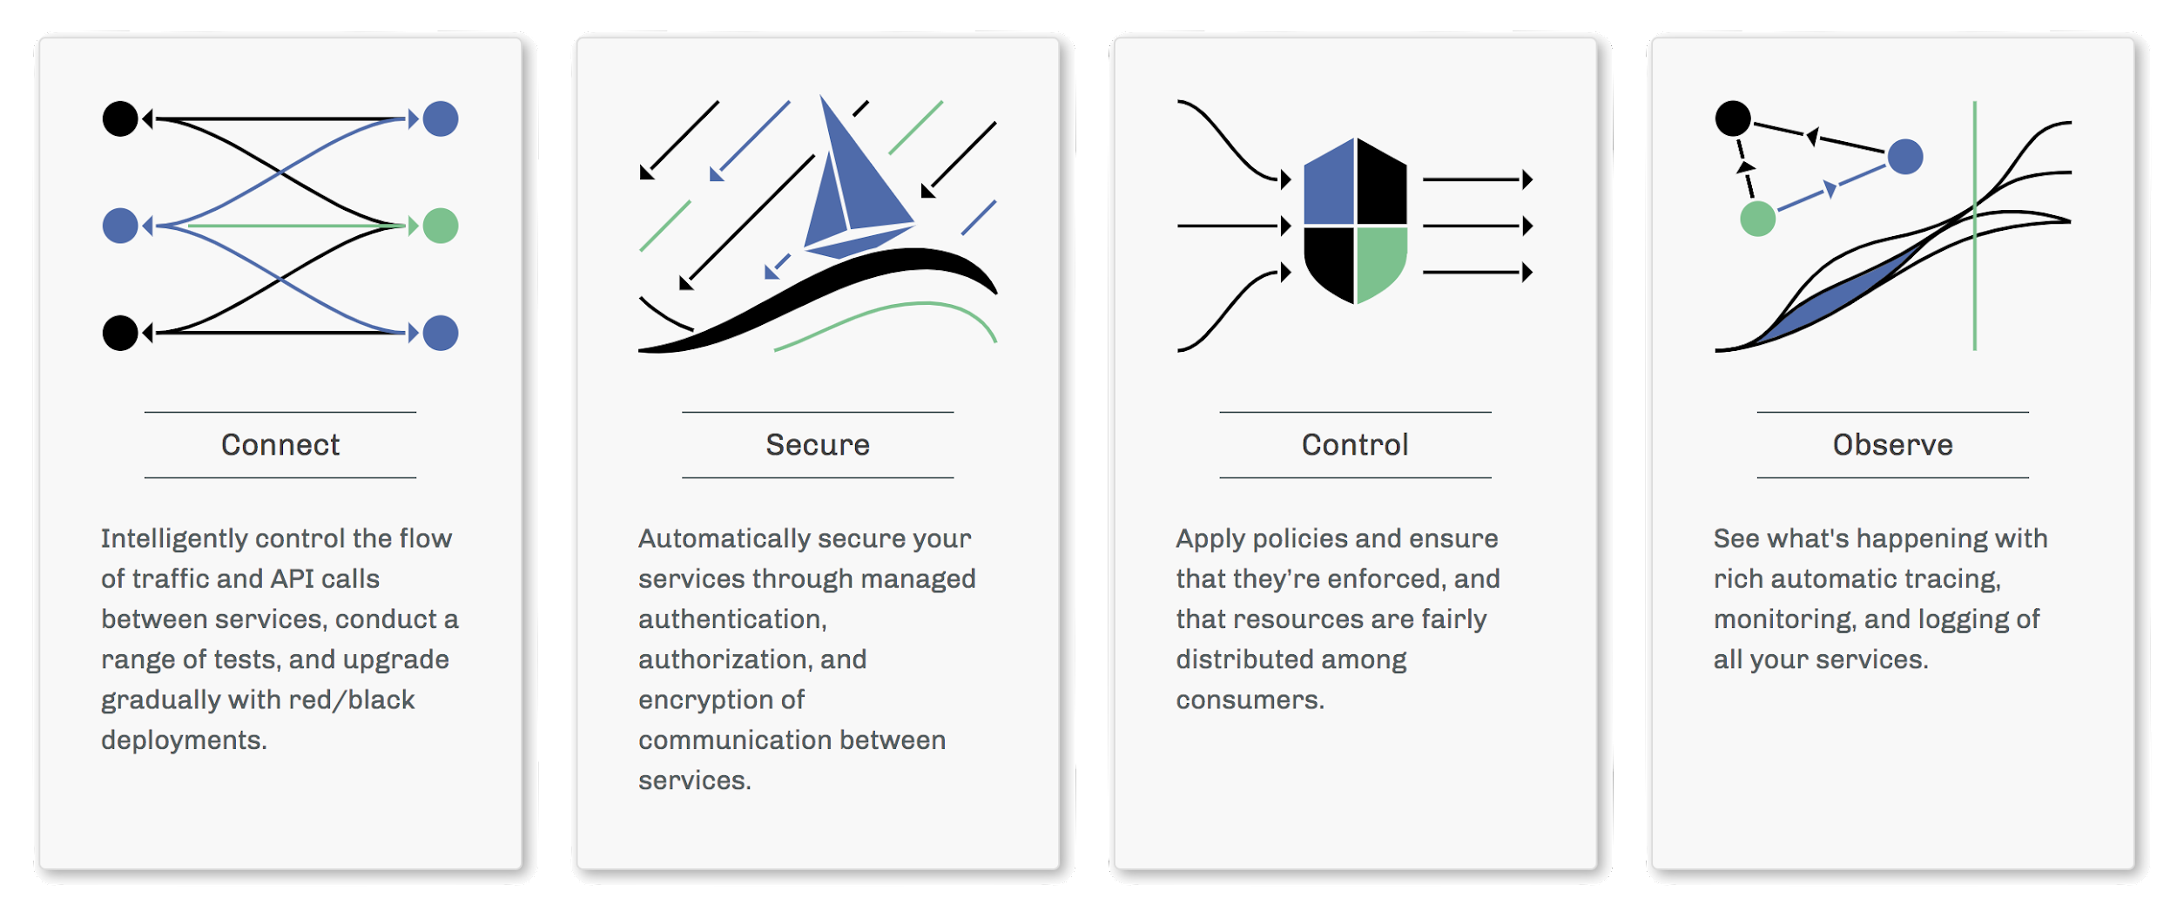
ISTIO SERVICE MESH
A modern way to manage the complexity of microservice applications
Notes:
(Chris)
A service mesh is ...
So at 10,000 ft istio enables:
Connect - Traffic mgmt by providing you the ability to configure rules to routing traffic between services - catch issues before they cause problems, make calls more reliable, and your network more robust
Secure - Service identity and security of the underlying secure communication channel, so developers can focus on the applications and app level security
Control - Policy enforcement that is configurable so that you can increase service uptime and reduce the chance unexpected events break the system
Observe - Observability logging so that you can detect and fix issues quickly

Slide 10
SERVICE MESH ARCHITECTURE 2.0+
Mixer now as Envoy plug-ins
Istio Extensions API is WIP
Optional native Envoy plug-ins
WebAssembly for ease of distribution and control
WASM support is being integrated in upstream Envoy
Ongoing effort to define a Proxy ABI for WASM, with PoC’s for Envoy and Apache TS
Service A
Service B
Data Plane
Envoy
Envoy
API-M
Control Plane
Control Plane
WASM VM
WASM VM
Authorization Cache
APIM
Notes:
Istio mesh divided into a data plane and a control plane –
The data plane consists of an intelligent proxy (Envoy) deployed as sidecars in parallel to app containers.
Ingress and egress control for each service within the service mesh
These proxies control all network communication between Microservices. The mixer is used as a policy and telemetry central hub.
Control plane configures Mixers to enforce policies on apps and collect telemetry info to be sent to monitoring systems.

Slide 11
SERVICE MESH ARCHITECTURE AND FEATURES
Split between Data plane and Control plane.
The Data Plane is based on Envoy, a smart reverse proxy, deployed together with the application in a transparent way.
The Control Plane provides the configuration to all the Envoy proxies in the data plane.
Mixer is used for telemetry and Policy enforcement.
Service A
Service B
Envoy
Envoy
Policy and Telemetry Checks
Istio Control Plane
Adapter
Mixer
Adapter
Config data to proxies
Configuration Data
TLS Certificates to proxies
Pilot
Galley
Citadel
Notes:
The architecture of the system is modeled in the same way as most well designed distributed systems, through the use of a control plane and a data plane. A failure of the control plane does not cause the failure of applications in the data plane, only the inability to affect state changes. As such, this allows us to safely perform upgrades, patches, and maintenance on the control plane knowing that our applications will continue running smoothly.
Istio mesh divided into a data plane and a control plane –
The data plane consists of an intelligent proxy (Envoy) deployed as sidecars in parallel to app containers.
Ingress and egress control for each service within the service mesh
These proxies control all network communication between Microservices. The mixer is used as a policy and telemetry central hub.
Control plane configures Mixers to enforce policies on apps and collect telemetry info to be sent to monitoring systems.

Slide 12
Demo

Slide 13
DEMO: A/B DEPLOYMENT WITH ISTIO
POD
SERVICE
B:v3
POD
50% traffic
SERVICE
A
ENVOY
POD
ENVOY
SERVICE
B:v1
50% traffic
ENVOY
Notes:
A/B testing (also known as split testing or bucket testing) is a method of comparing two versions of a webpage or app against each other to determine which one performs better. AB testing is essentially an experiment where two or more variants of a page are shown to users at random, and statistical analysis is used to determine which variation performs better for a given conversion goal.

Slide 14

DEMO: FAULT TOLERANCE
TIMEOUTS AND RETRIES WITH ISTIO
POD
POD
POD
SERVICE
A
SERVICE
B
SERVICE
C
ENVOY
ENVOY
ENVOY
timeout: 15 sec
retry: 5
timeout: 10 sec
retry: 5
configure timeouts and retries, transparent to the services
Notes:
We can also implements timeouts and retries at the network level, rather than having to hard code those values into each service, requiring re-deployments every time we wanted to change them.

Slide 15
Thank you
Red Hat is the world’s leading provider of enterprise open source software solutions. Award-winning support, training, and consulting services make Red Hat a trusted adviser to the Fortune 500.

Slide 16
DISTRIBUTED TRACING
(JAEGER)

Slide 17
DISTRIBUTED TRACING WITHOUT ISTIO
SERVICE
A
SERVICE
B
SERVICE
C
Spring Sleuth ZipKin
Spring Sleuth ZipKin
Spring Sleuth ZipKin
code to enable dynamic tracing

Slide 18
DISTRIBUTED TRACING WITH ISTIO & JAEGER
POD
POD
POD
SERVICE
A
SERVICE
B
SERVICE
C
ENVOY
ENVOY
ENVOY
discovers service relationships and process times, transparent to the services
SERVICE A
210 ms
SERVICE B
720 ms
SERVICE C
930 ms

Slide 19
SERVICE MESH OBSERVABILITY
(KIALI)

Slide 20
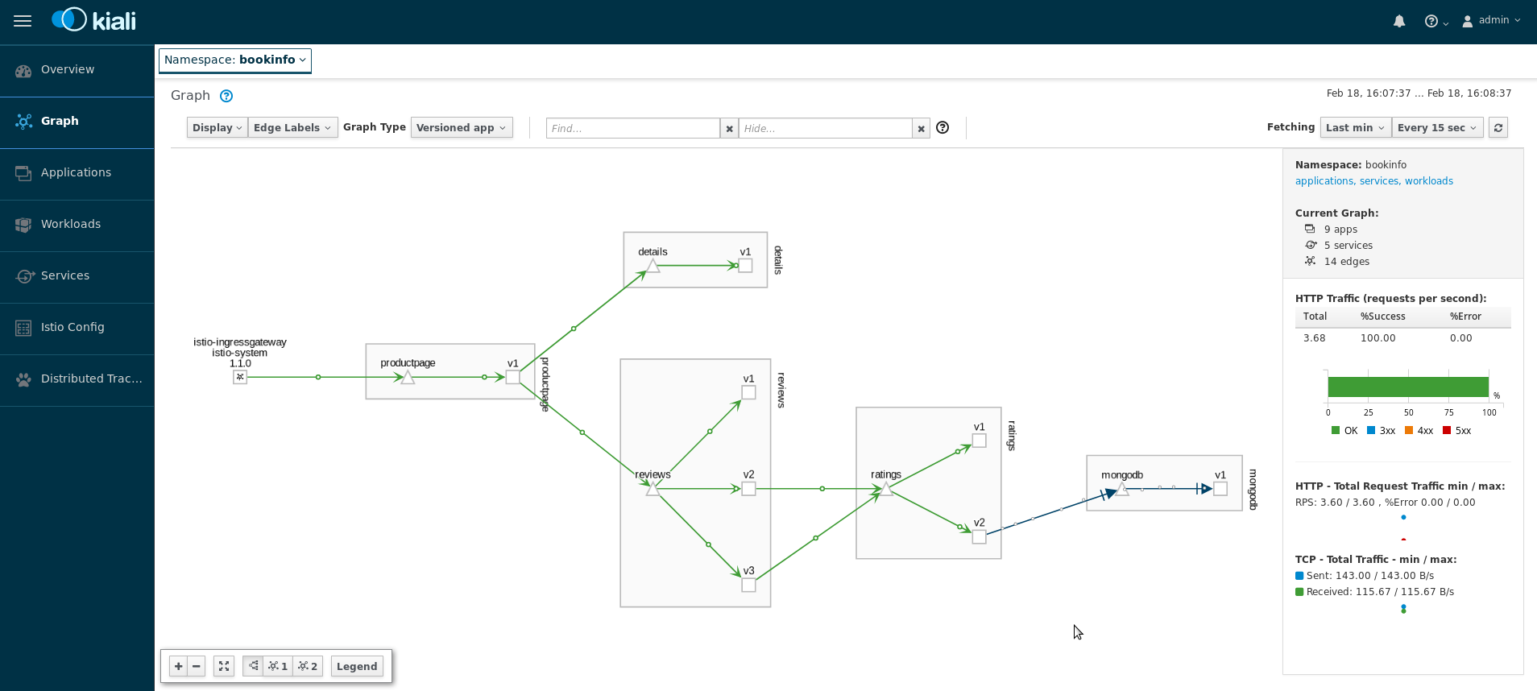

Slide 21
DISTRIBUTED SERVICES PLATFORM
Service
CONTAINER
Service
CONTAINER
Service
CONTAINER
Service
CONTAINER
Service
CONTAINER
ANY
APPLICATION
OpenShift Service Mesh (Istio + Jaeger + Kiali)
OpenShift Container Platform
(Enterprise Kubernetes)
ANY
INFRASTRUCTURE
Laptop
Datacenter
OpenStack
Amazon Web Services
Microsoft Azure
Google Cloud

Slide 22
TAKEWAY

Slide 23
BUILD AND DEPLOY CLOUD-NATIVE APPS
WITH RED HAT OPENSHIFT
Service
CONTAINER
Service
CONTAINER
Service
CONTAINER
Service
CONTAINER
Service
CONTAINER
ANY
APPLICATION
OpenShift Container Platform
(Enterprise Kubernetes)
Build Automation
Service Discovery
Monitoring
Security
Deploy Automation
Config Mgmt
Log Mgmt
CI/CD Pipelines
ANY
INFRASTRUCTURE
Laptop
Datacenter
OpenStack
Amazon Web Services
Microsoft Azure
Google Cloud
Notes:
OpenShift is an Enterprise Kubernetes for production. OpenShift takes care of build, deployment, configuration and service discovery for the distributed services, it’s grown in popularity along with Kubernetes, but we realized that the development of applications for containerized environments could be optimized, much in the same way we’ve optimized many other areas of application management like log management, continuous integration/continuous deployment (CI/CD), automation, and security enhancements. This lead us to pursue the development of a technology called “a service mesh”.

Slide 24
OVERVIEW

Slide 25
WHAT IS A SERVICEMESH ?
Machine A (Monolith)
Machine B
Circuit Breaker
Circuit Breaker
Service A
Discovery
Discovery
Service B
Tracing
Tracing
Proxy
Proxy
NETWORK
Notes:
A service mesh is a dedicated infrastructure layer for handling service-to-service communication. It’s responsible for the reliable delivery of requests through the complex topology of services that comprise a modern, cloud native application. In practice, the service mesh is typically implemented as an array of lightweight network proxies that are deployed alongside application code, without the application needing to be aware.

Slide 26


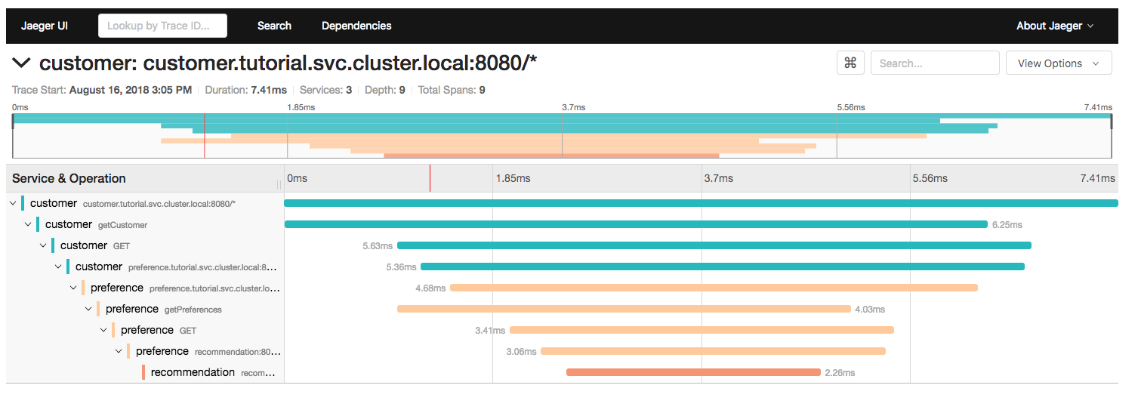

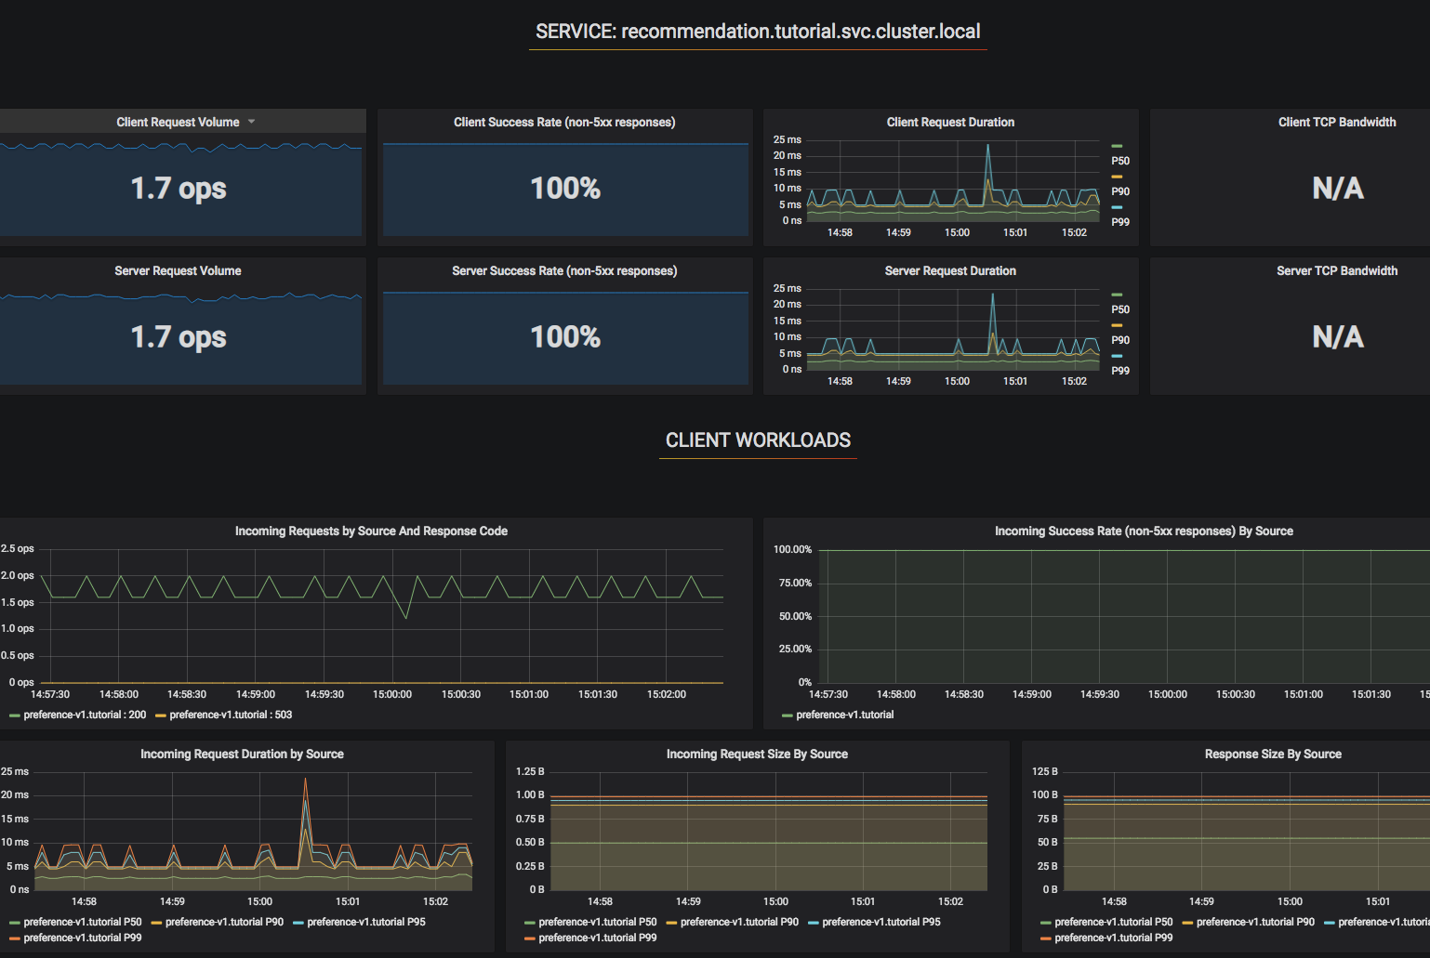
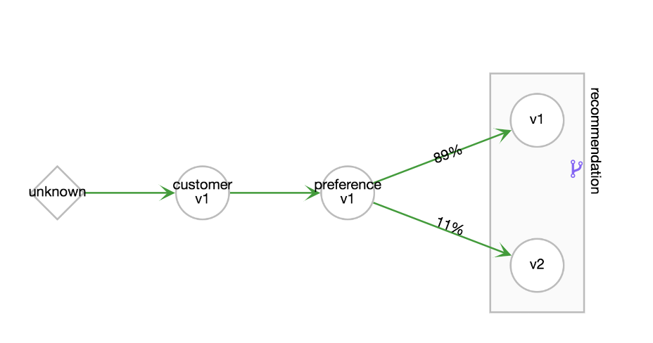


SERVICE MESH ECOSYSTEM
Secure
Istio
Jaeger
Prometheus
Observe
Observe
Connect
Control
Kiali
Grafana
Notes:
The components of OpenShift service mesh are broken down as follows:
Istio is at the heart of our solution, comprising of a coordinator for scheduling a series of proxy servers which allow us to control the flow of traffic throughout the system.
For providing telemetry and visualization of a wide swath of metrics we include prometheus and grafana. This combination allows us to automatically capture information directly from a number of network endpoints (Envoy Proxies) deployed as a part of the mesh and produce graphs because of the strong structuring of data.
Jaeger is included as an open tracing compliant answer for capturing requests spanning across multiple services within the mesh. This gives us the capability of correlating data across and entire call chain between services.
Finally, Kiali is a net-new project created by Red Hat specfiically for use with Istio allowing for the visualization of an entire graph of services scheduled within an instance of the service mesh.

Slide 27
DISTRIBUTED SERVICES WITH
RED HAT OPENSHIFT SERVICE MESH
SERVICE
Service
CONTAINER
Service
CONTAINER
Service
CONTAINER
Service
CONTAINER
Service
CONTAINER
ANY
APPLICATION
OpenShift Service Mesh (Istio + Jaeger + Kiali)
SERVICE OPS
OpenShift Container Platform
(Enterprise Kubernetes)
INFRA OPS
ANY
INFRASTRUCTURE
INFRA
Laptop
Datacenter
OpenStack
Amazon Web Services
Microsoft Azure
Google Cloud
Notes:
When deployed as a part of OpenShift, this adds another layer of control to your infrastructure allowing for additional configurability of your services.

Slide 28

HOW TO DEAL WITH THE COMPLEXITY?
Photo by Clint Adair on Unsplash
Notes:
Let’s look at how we have been dealing with these complexities

Slide 29
DEPLOYMENT
Service
Container
Service
Container
Service
Container
INFRASTRUCTURE
Notes:
Containers have simplified deployment of the services by packaging the app and all its dependencies into an immutable package which is independent of the frameworks and programming languages used to build the application. They are lighter and easier to build and share around

Slide 30

CONFIGURATION
Spring Cloud
Config Server
Service
Service
Service
Config
Config
Config
INFRASTRUCTURE
Notes:
Then we had to solve the configuration management. Deploy a config server and add some code into the service to talk to it

Slide 31

SERVICE DISCOVERY
Service
Service
Service
Spring Cloud
Config Server
Netflix Eureka
Netflix Ribbon
Svc Discovery
Svc Discovery
Svc Discovery
Config
Config
Config
INFRASTRUCTURE
Notes:
We have lots of services and they should be able to find each other. Netflix has some libraries for that that you can deploy on some piece of your infrastructure and add some code to your services to talk to that

Slide 32
DYNAMIC ROUTING
Netflix Zuul
Server
Service
Service
Service
Spring Cloud
Config Server
Netflix Eureka
Netflix Ribbon
Routing
Routing
Routing
Svc Discovery
Svc Discovery
Svc Discovery
Config
Config
Config
INFRASTRUCTURE
Notes:
Dynamic routing is also needed to manage traffic flow to services specially if you are running multiple versions of the same service. Netflix Zuul is another library that helps you with that

Slide 33
FAULT TOLERANCE
Netflix Zuul
Server
Service
Service
Service
Spring Cloud
Config Server
Netflix Eureka
Netflix Ribbon
Circuit Breaker
Circuit Breaker
Circuit Breaker
Routing
Routing
Routing
Svc Discovery
Svc Discovery
Svc Discovery
Config
Config
Config
INFRASTRUCTURE
Notes:
Dynamic routing is also needed to manage traffic flow to services specially if you are running multiple versions of the same service. Netflix Zuul is another library that helps you with that

Slide 34

TRACING AND VISIBILITY
Netflix Zuul
Server
ZipKin Server
Service
Service
Service
Tracing
Tracing
Tracing
Spring Cloud
Config Server
Netflix Eureka
Netflix Ribbon
Circuit Breaker
Circuit Breaker
Circuit Breaker
Routing
Routing
Routing
Svc Discovery
Svc Discovery
Svc Discovery
Config
Config
Config
INFRASTRUCTURE
Notes:
Tracing become more and more important so that you can see how the requests flow between services as you have many services chained together to respond to a user request. You can deploy a ZipKin server somewhere on your infrastructure and add some code to each service to export some data to ZipKin server. ZipKin does the rest of the job and correlates and visualises the flows which is extremely helpful for troubleshooting and visibility.

Slide 35


WHAT ABOUT…?
POLYGLOT
APPS
EXISTING
APPS
Notes:
Services are made responsible to address the complexity of distributed architectures
What about existing apps?
You have rewire them to be able to support these capabilities?
What about other languages?
You have to find other frameworks that might provide similar functionality
Or you might have to implement yourself
Ending up with a variety of frameworks and libraries that solve these complexities in different ways
Isn’t there a better way?

Slide 36
THERE SHOULD BE A
BETTER WAY
Notes:
At Red Hat we felt that there could be a better answer in the future

Slide 37
ADDRESS THE COMPLEXITY
IN THE INFRASTRUCTURE
Notes:
… and this answer was to solve more of these challenges external to the applications.

Slide 38
AUTOMATING CONTAINER DEPLOYMENT
POD
POD
POD
SERVICE
CONTAINER
SERVICE
CONTAINER
SERVICE
CONTAINER
KUBERNETES
INFRASTRUCTURE
Notes:
Although containers make it simple to build immutable packages which are independent of the infrastructure, in order to deploy and managed many of them on top of your infrastructure you need some sort of container orchestration which automates the job. Kubernetes is the defacto standard in container orchestration. Unit of deployment in k8s is call pod. A pod is like a host that has multiple containers running in them, it has a network space and can have storage in it. Most often there is one container running in a pod but sometimes you might want more than one container. You will see one of these cases in a little bit.

Slide 39
SIDECARS
Two or more containers deployed to same pod
Share
Same
Namespace
Pod IP
Shared lifecycle
Used to enhance the co-located containers
Istio Proxy (L7 Proxy)
Proxy all network traffic in and out of the app container
POD
SERVICE A
Istio Proxy
Source: http://blog.kubernetes.io/2015/06/the-distributed-system-toolkit-patterns.html
Notes:
A sidecar container is a pattern where two or more containers are deployed to the same Pod. The containers shares the same namespace, network and other resources, and all containers in a pod share the same lifecycle. The sidecar pattern is often used to enhance an application container. In Istio the sidecar pattern is used to add a container called “Envoy proxy”. The envoy sidecar container can be deployed manually or automatically injected to applications in a namespace. When injected all (or part of) the network traffic to the original container is routed via the proxy. The envoy proxy in itself is very simplistic and written in a way so that the performance overhead is very low.

Slide 40
FAULT TOLERANCE
Notes:
This first major area of functionality is fault tolerance. This means the ability to operate even when components of our application stacks fail, either by redirecting traffic or retrying requests.

Slide 41
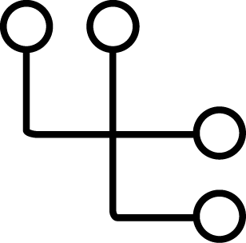
CIRCUIT BREAKERS WITHOUT ISTIO
SERVICE
A
SERVICE
B
SERVICE
C
CB
CB
coupled to the service code
Notes:
Circuit breakers reflect the need to redirect traffic as parts of our environment change or fail. Much in the same way we will cut power to parts of a home in an unsafe situation, we can block traffic or redirect it in the case of a failure. In the Netflix model this requires making changes to each application component, instructing it to request information from our service discovery endpoints to ensure that it knows which endpoint to go to next. You can think of this as a giant case statement, switch statement, or big group of “if then” decisions which each application owner has to decide about on their own.

Slide 42
CIRCUIT BREAKERS WITH ISTIO
POD
POD
POD
SERVICE
A
SERVICE
B
SERVICE
C
ENVOY
ENVOY
ENVOY
transparent to the services
Notes:
In the realm of OpenShift Service Mesh we can make this transparent to the services...

Slide 43
CIRCUIT BREAKERS WITH ISTIO
POD
POD
POD
SERVICE
A
SERVICE
B
SERVICE
C
ENVOY
ENVOY
ENVOY
improved response time with global circuit status
Notes:
Thus, if service B were to fail, we can actually redirect requests around service B, allowing us to bypass the failed service and send the request to a different endpoint or even just skipping that hop.

Slide 44

RATE LIMITING WITH ISTIO
POD
POD
POD
SERVICE
A
SERVICE
B
SERVICE
C
ENVOY
max 100 connections
ENVOY
max 500 concurrent reqs
ENVOY
limit invocation rates, transparent to the services
Notes:
We can also implement rate limiting, allowing us to protect services against large amount of request (e.g. denials of service), potentially beyond what the services were designed to accommodate

Slide 45
SERVICE SECURITY
Notes:
The next major category of functionality is service to service security

Slide 46

SECURE COMMUNICATION WITHOUT ISTIO
SERVICE
A
SERVICE
B
SERVICE
C
TLS
TLS
TLS
TLS
coupled to the service code
Notes:
Without Istio, the TLS communication should get handled within the service code
Depending on the programming language and frameworks used, the implementation would varies and should get adjusted to each application
All existing application, have to get refactored in order to be able to handle TLS communications

Slide 47
SECURE COMMUNICATION WITH ISTIO
POD
POD
POD
SERVICE
A
SERVICE
B
SERVICE
C
ENVOY
ENVOY
ENVOY
TLS
TLS
mutual TLS authentication, transparent to the services
Notes:
The service code does not need to know anything about the TLS communications or certificates and the service only communicates with the local envoy proxy
Envoy proxy secures all communicates between proxies (services) with mutual TLS and rotates certificates and keys for maximum security
Any application (existing or new) using any programming language and framework would immediately be able to take advantage of mutual TLS security without any refactoring

Slide 48
CONTROL SERVICE ACCESS WITH ISTIO
POD
POD
POD
SERVICE
A
SERVICE
B
SERVICE
C
ENVOY
ENVOY
ENVOY
control the service access flow, transparent to the services
Notes:
We can also then use this infrastructure for handling mutual authentication between services through the use of client based certificates. In this case Service C would only allow connections from the cert possessed by Service B. This ensures that even in the event that Service A is compromised, we can have complete certainty that it would not be able to access resources it is unauthorized to access.

Slide 49
CHAOS ENGINEERING

Slide 50


CHAOS ENGINEERING WITHOUT ISTIO
SERVICE
A
SERVICE
B
SERVICE
C
random termination
Netflix Spinnaker
Netflix Chaos Monkeys
Notes:
Termination simulates network level failures

Slide 51
CHAOS ENGINEERING WITH ISTIO
POD
POD
POD
SERVICE
A
SERVICE
B
SERVICE
C
ENVOY
ENVOY
ENVOY
10 sec delay
in 10% of requests
inject delays, transparent to the services
Notes:
Istio enables protocol-specific fault injection into the network, instead of killing pods, delaying or corrupting packets at TCP layer. The rationale is that the failures observed by the application layer are the same regardless of network level failures, and that more meaningful failures can be injected at the application layer (e.g., HTTP error codes) to exercise the resilience of an application.
Two types of faults can be injected: delays and aborts. Delays are timing failures, mimicking increased network latency, or an overloaded upstream service. Aborts are crash failures that mimick failures in upstream services. Aborts usually manifest in the form of HTTP error codes, or TCP connection failures.

Slide 52

CHAOS ENGINEERING WITH ISTIO
POD
POD
POD
SERVICE
A
SERVICE
B
SERVICE
C
ENVOY
ENVOY
ENVOY
HTTP 400 in 5% of requests
inject protocol-specific errors, transparent to the services
Notes:
Two types of faults can be injected: delays and aborts. Delays are timing failures, mimicking increased network latency, or an overloaded upstream service. Aborts are crash failures that mimick failures in upstream services. Aborts usually manifest in the form of HTTP error codes, or TCP connection failures.
Delay and abort can also be configured together for example to delay 10% of requests and return 404 on 20% of the same requests

